Slide 1
EONS.SECRETARIAT@CANCERNURSE.EU
WWW.CANCERNURSE.EU
Join Us

Slide 2
WHO WE ARE
Overview: The European Oncology Nursing Society (EONS) is dedicated to supporting and developing cancer nursing across Europe.
Mission: To enhance the quality of cancer care through education, research, and leadership.

Slide 3
Benefits of EONS Membership
Professional Development: Access to educational resources and workshops to advance your career.
Networking Opportunities: Connect with a vast network of cancer nursing professionals across Europe.
Join Committees and Working Groups: Participate in Committees and Working Groups to shape the future of the profession.

Slide 4
Our Members Can…

Slide 5
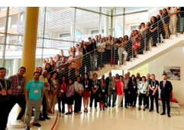
Educational Opportunities
Workshops and Masterclasses: Eligibility to apply for EONS learning activities, including research workshops and masterclasses.
Online Resources: Access to a wealth of educational materials and the EONS online Newsletter archive.

Slide 6
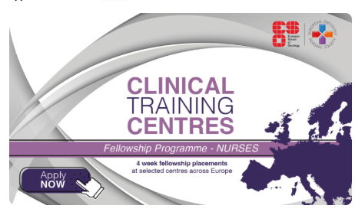
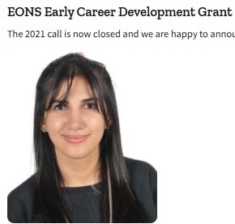
Research and Grants
Funding Opportunities: Eligibility to apply for EONS awards, grants, and fellowships to support your research initiatives.
Collaborative Projects: Opportunities to participate in educational and research projects with peers across Europe.

Slide 7
Conferences and Events
Reduced Registration Rates: Enjoy discounted rates for EONS congresses and endorsed events.
Grants for Attendance: Access to grants available for attending EONS congresses and endorsed events.

Slide 8
Membership Fees
Individual Membership: Annual fee of €45 for the period from January to December 2024
National Society Memberships
34 Member Societies across Europe
4 different rates available at www.cancernurse.eu/membership/society-membership-3/
c) Associate Memberships
Become part of the EONS network for as little as €275 annually!
Join today to enhance cancer nursing development and enhance your organization’s visibility.

Slide 9
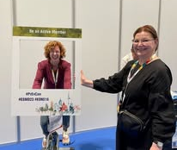
Why to Join EONS?
Are you passionate about advancing your career in cancer nursing?
Join EONS and become part of a dynamic community dedicated to improving cancer care across Europe.

Slide 10
Key messages from our members
Access cutting-edge education, research, and resources tailored for cancer nurses.
Network with experts and peers to share knowledge and best practices.
Shape the future of cancer care through advocacy and professional development opportunities.
Empower yourself. Empower your patients.
Together, we make a difference.
Be the change in cancer nursing — Join EONS today!

Slide 11
How to Join EONS
Application Process: Complete the online application form available on the EONS website:
A. Individuals → https://docs.google.com/forms/d/e/1FAIpQLSdj0vwtdKmS8UDs62GEiRa7iu8uHMCm4Q2Wm2SSmpCCB8bIhA/viewform
B. National Society → https://docs.google.com/forms/d/e/1FAIpQLScL80zcgkGAe3-sHmTs5cbCHkCdFHgHYtcWAUKy3g4r1akkhg/viewform
C. Associate → https://docs.google.com/forms/d/e/1FAIpQLSdJ6MpXpFLHa8bBkWaU-b3s7wPIk097DWOROCfnxJ4u-9VvOg/viewform
Payment Instructions: Follow the provided guidelines to submit your membership fee promptly.
Renew your membership for 2025 by January 31, 2025 at
www.cancernurse.eu/membership/

Slide 12
Partner Collaboration
EONS collaborates with a diverse array of partners to advance cancer nursing across Europe.
These partnerships encompass professional organizations, healthcare institutions, academic entities, and industry stakeholders, all dedicated to enhancing cancer nursing practice, education, research, and policy.

Slide 13
Conclusion and Call to Action
Join a Vibrant Community: Become part of a dynamic network dedicated to excellence in cancer nursing.
Enhance Your Career: Leverage the numerous benefits of EONS membership to advance your professional journey.
Get Involved: Visit the EONS website to learn more and start your membership application today.

